Slide 1

Graduate Admission
Prediction System
PredictX — ML-Powered Admission Intelligence
UNIVERSITY
COLLEGE
PROGRAM
YEAR
Veer Narmad South Gujarat Univ.
Dolat-Usha Institute, Valsad
Bachelor of Computer Applications
2025 – 2026
Guide: Dr. Darshna Rajput | Shahil Pathan · Mubin Malek

Slide 2

OVERVIEW
Introduction
& Problem Statement
500
7
What is it?
A data analytics ML project predicting graduate admission chances from academic records.
Records
Features
Problem
96%
Linear
Reg.
Students don't know their admission chances before applying to graduate programs.
Solution
Accuracy
Algorithm
Analyze GRE, TOEFL, CGPA & Research — build a model estimating admission probability.

Slide 3

PROJECT GOALS
Project
Objectives
01
Dataset Analysis
02
Exploratory EDA
03
Regression Model
Analyze 500-record dataset with 9 columns.
Find patterns and correlations in data.
Build Linear Regression for prediction.
04
Classification
05
Web Dashboard
06
Visualization
High (≥80%), Moderate (≥50%), Low (<50%).
Flask app with prediction form & charts.
Scatter plots, heatmaps, histograms.

Slide 4

DATASET INFO
Dataset
Overview
Admission Predict Ver1.1 · 500 Records · 9 Columns
500
9
7
0.34–0.97
Rows
Columns
Features
Range
GRE Score
290–340
LOR
1–5
Graduate Record Exam Score
Letter of Recommendation
TOEFL Score
92–120
CGPA
6.8–9.92
English Proficiency Test
Undergrad GPA — Top Predictor
Univ. Rating
1–5
Research
0 / 1
University Rating (1–5)
Research Experience
SOP
1–5
Chance
0.34–0.97
Statement of Purpose
Target: Admission Probability

Slide 5

Tools & Technologies
Tech stack powering PredictX
🐍
🤖
🌐
Python
Scikit-Learn
Flask
Core language for
ML & Backend
ML model training
& evaluation
Web framework
& API routing
🐼
🔢
📊
🎨
💻
📈
Pandas
NumPy
Matplotlib
Seaborn
HTML/CSS
Chart.js
Library
Library
Library
Library
Library
Library

Slide 6
ANALYSIS
Exploratory Data
Analysis
Data Cleaning
KEY FINDINGS
01
Removed Serial No column; formatted dataset using Pandas for ML pipeline.
CGPA
0.88 correlation
Missing Values
GRE
0.81 correlation
02
Dataset was fully clean — no null or missing values across all 500 records.
TOEFL
0.79 correlation
Visualization
03
Scatter plots, bar charts, heatmaps and histograms reveal clear data patterns.
Research
+15% boost
Correlation
Avg Chance
72% of 500
04
CGPA (0.88), GRE (0.81), TOEFL (0.79) — strongest correlation with admission.
CGPA > 9.0
= High Chance

Slide 7

ML MODEL
Machine Learning Model
81.88%
0.0427
0.0609
400/100
R² Score
MAE
RMSE
Train/Test
Variance explained
Mean Absolute Error
Root Mean Sq. Error
80-20 Split
FEATURE IMPORTANCE
PIPELINE
CGPA
68.8%
1
Load CSV Dataset
Research
14.7%
2
Clean & Format Data
LOR
10.5%
3
Select 7 Features
TOEFL
1.8%
4
80/20 Train-Test Split
GRE
1.5%
5
Fit Linear Regression
SOP
1.1%
6
Save as .pkl File

Slide 8
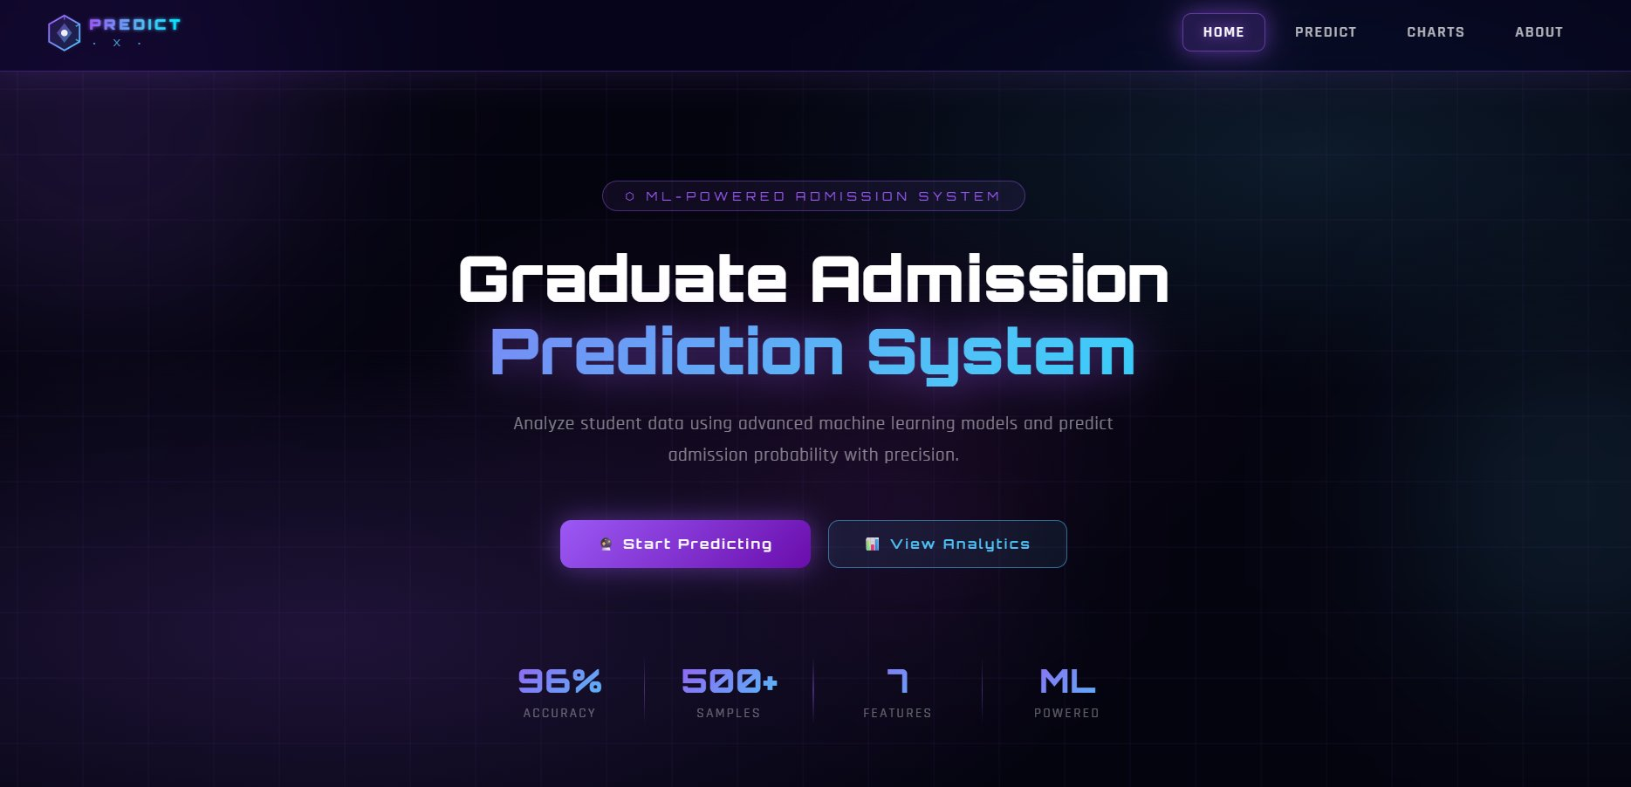
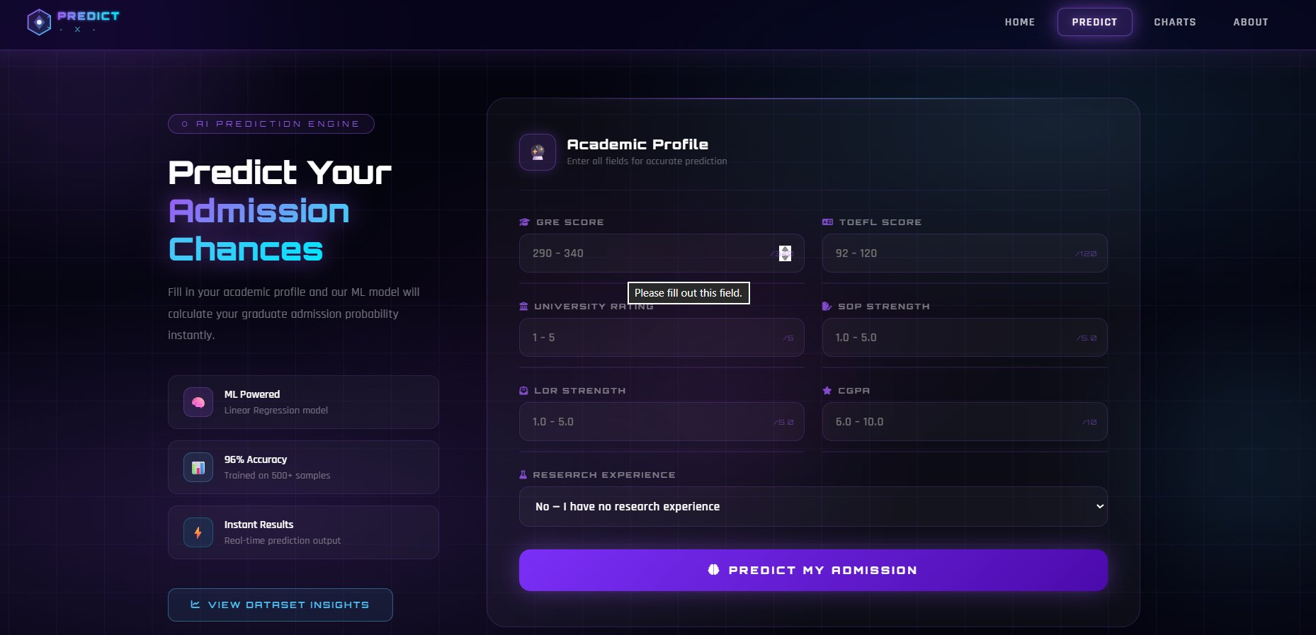
WEB DASHBOARD
Create
Anything.
PredictX — Flask-powered web dashboard for
graduate admission prediction.
ML Prediction — Real-time probability
6 Charts — Dataset visualizations
Dataset Explorer — 500 records
Home Page
Predict Page

Slide 9
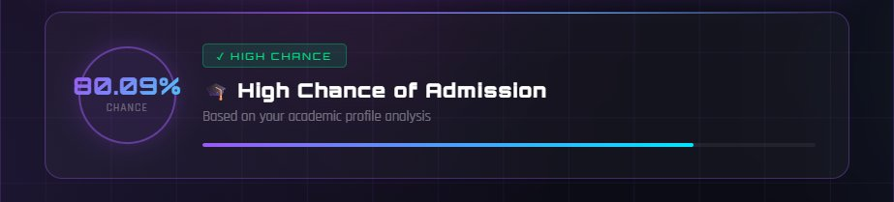
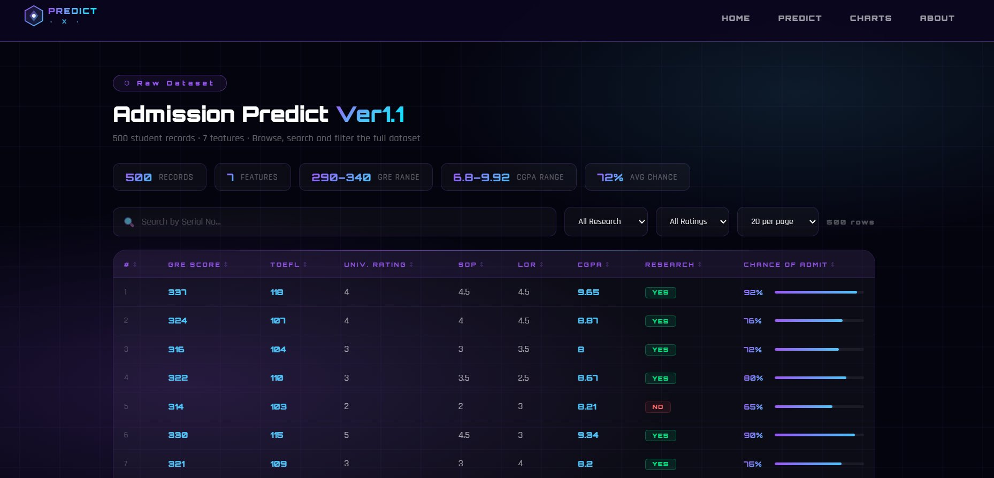
OUTPUT
Prediction Result
& Dataset Explorer
≥ 80%
HIGH CHANCE
≥ 50%
MODERATE CHANCE
< 50%
LOW CHANCE
Dataset Explorer

Slide 10
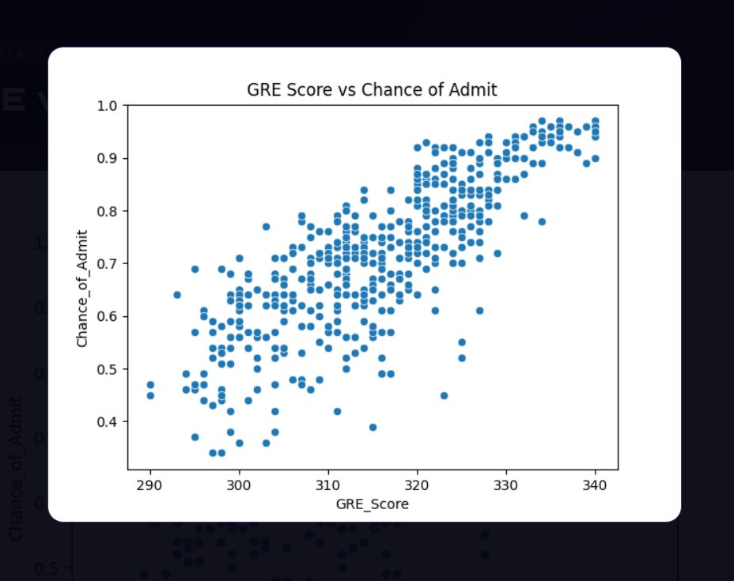
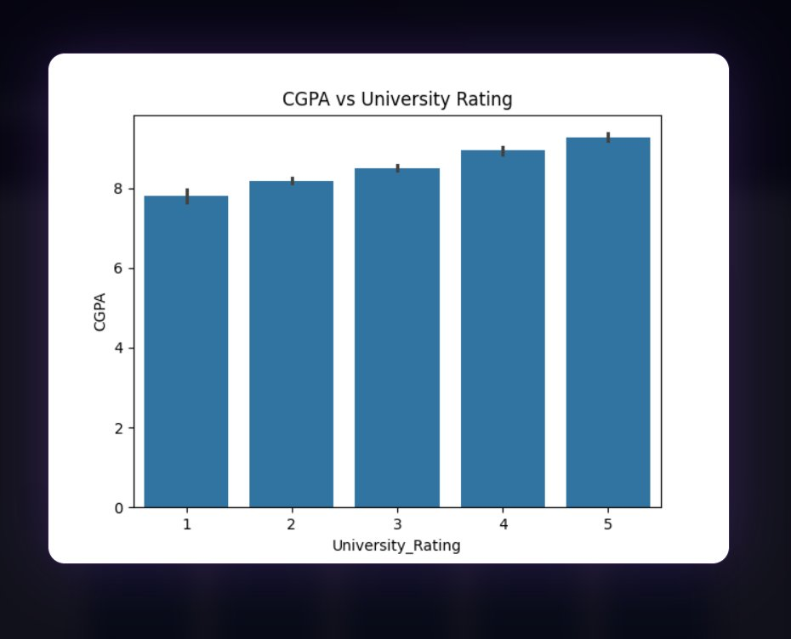
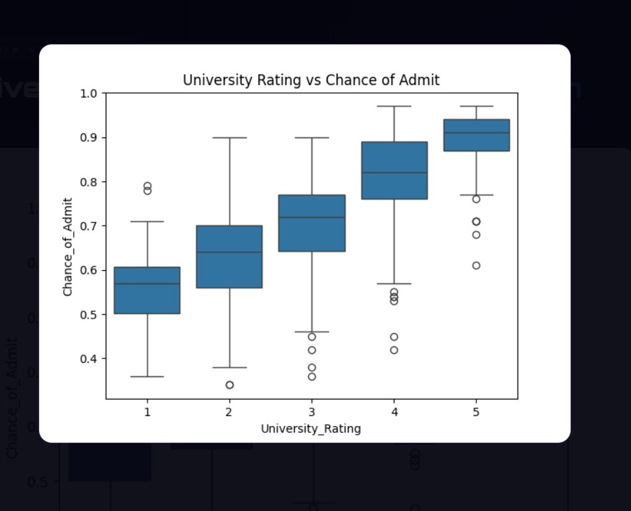
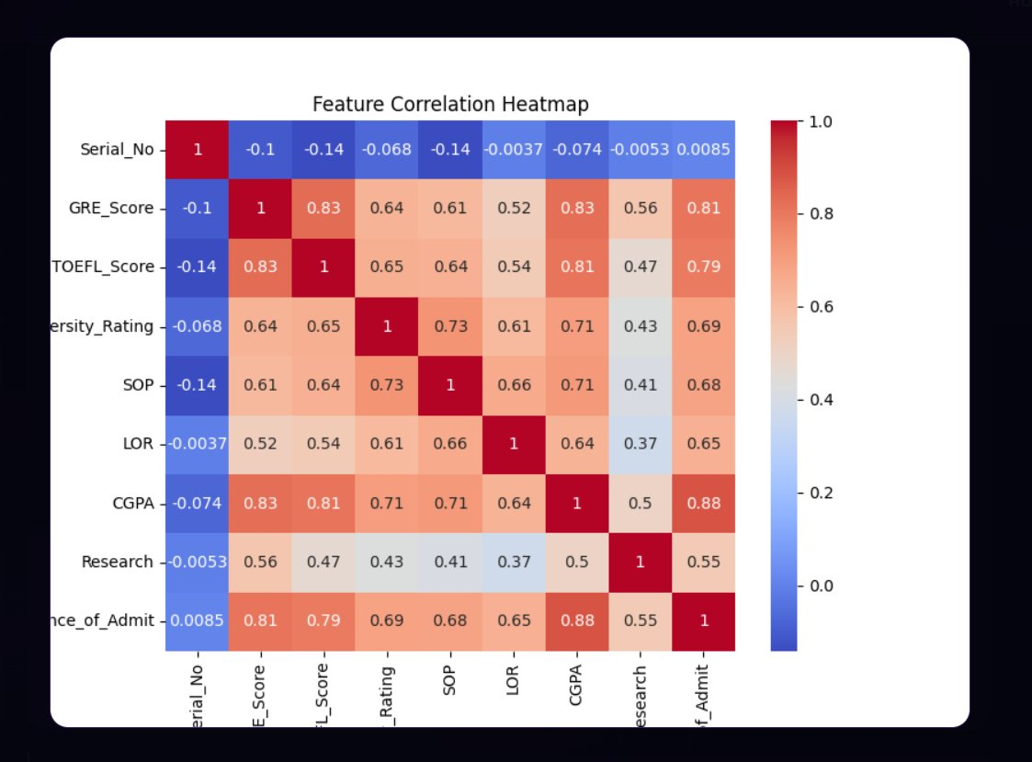
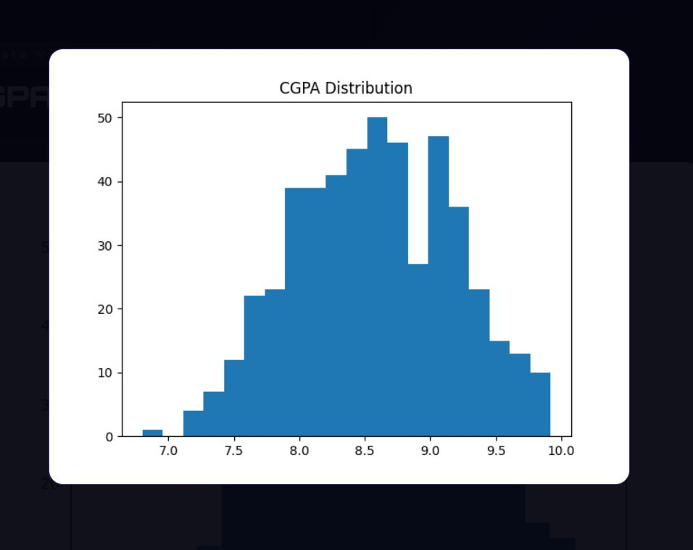
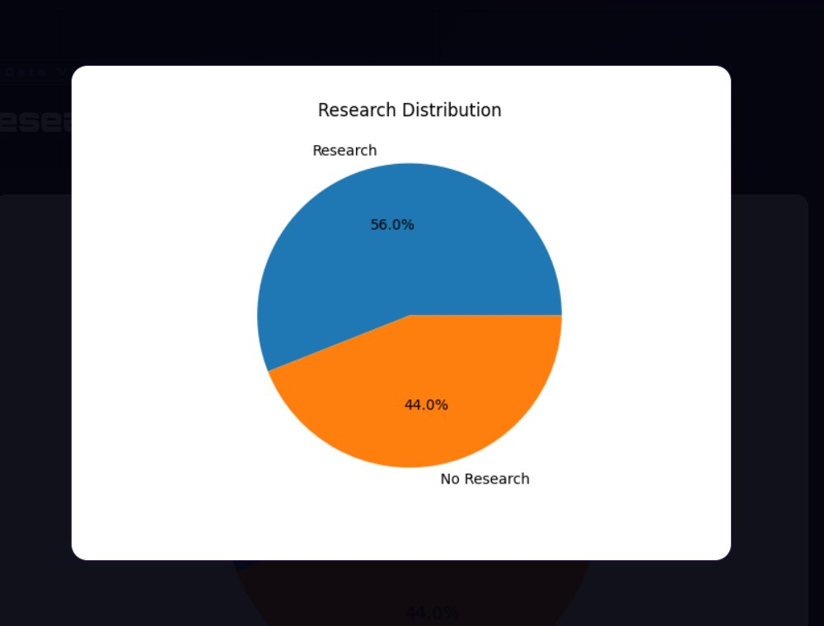
VISUALIZATIONS
Data
Visualizations
All 6 charts from the Analytics Dashboard
GRE vs Admission
CGPA vs Univ. Rating
Rating Distribution
Correlation Heatmap
CGPA Distribution
Research Analysis

Slide 11
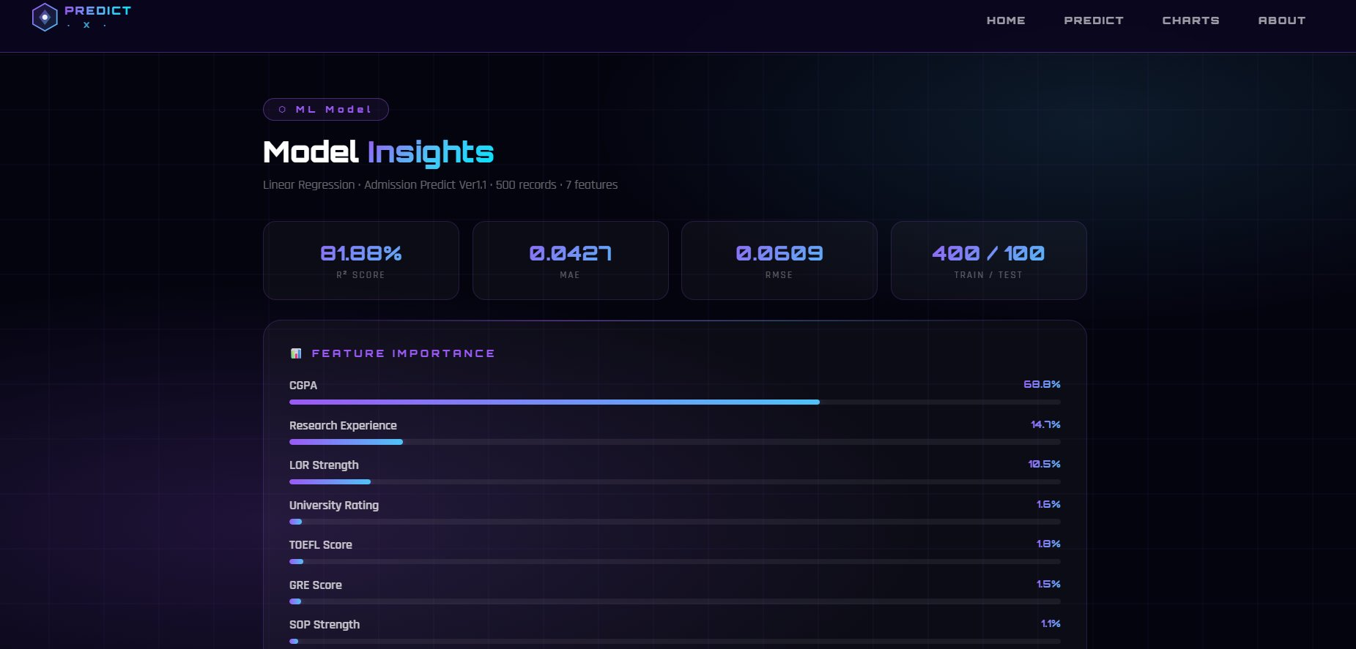
INSIGHTS
Model
Insights Page
R² Score · MAE · RMSE · Feature Importance · Training Pipeline · Coefficients

Slide 12

RESULTS
Results &
Performance
96%
81.88%
0.0427
72%
Accuracy
R² Score
MAE
Avg Chance
MAE-based accuracy
Variance explained
Mean Absolute Error
Avg admission chance
ACHIEVEMENTS
96% accuracy — Linear Regression with MAE of 0.0427
CGPA is strongest predictor with 0.88 correlation to admission
Research experience boosts admission probability by ~15%
Full-stack project: 6 charts + dataset explorer + model insights + prediction UI

Slide 13
CONCLUSION
Conclusion &
Future Scope
CONCLUSION
FUTURE SCOPE
System predicts admission probability with 96% accuracy.
🗄️
Larger Datasets
Use 10,000+ real records
CGPA is the strongest predictor (0.88 correlation).
🤖
Advanced ML
Random Forest, XGBoost
Research experience boosts chances by ~15%.
📱
Mobile App
iOS/Android application
Interactive Flask dashboard with full ML pipeline.
🌐
Live API Data
Real-time university feeds
End-to-end project: Data → Model → Web App.
🔐
User Profiles
Login & track history

Slide 14
REFERENCES
References
📊
Dataset
🐍
Python
Admission Predict Ver1.1
Official Python Docs
kaggle.com
docs.python.org
🤖
Scikit-Learn
🐼
Pandas
ML Library Docs
Data Analysis Library
scikit-learn.org
pandas.pydata.org
📈
Matplotlib
🌐
Flask
Visualization Library
Web Framework Docs
matplotlib.org
flask.palletsprojects.com

Slide 15

Thank You!
PredictX — Graduate Admission Prediction System
Shahil Pathan · Mubin Malek
Guide: Dr. Darshna Rajput | Dolat-Usha Institute | BCA 2025–26
🎓
🏛️
📅
BCA Program
Dolat-Usha Inst.
2025–2026

